Slide 1
THE WINDOW SURROUND
ARCHES * FRAMES * SURROUNDS
GFRC FACADES
EXTERIOR - DECORATIVE SOLUTION PROVIDER

Slide 2
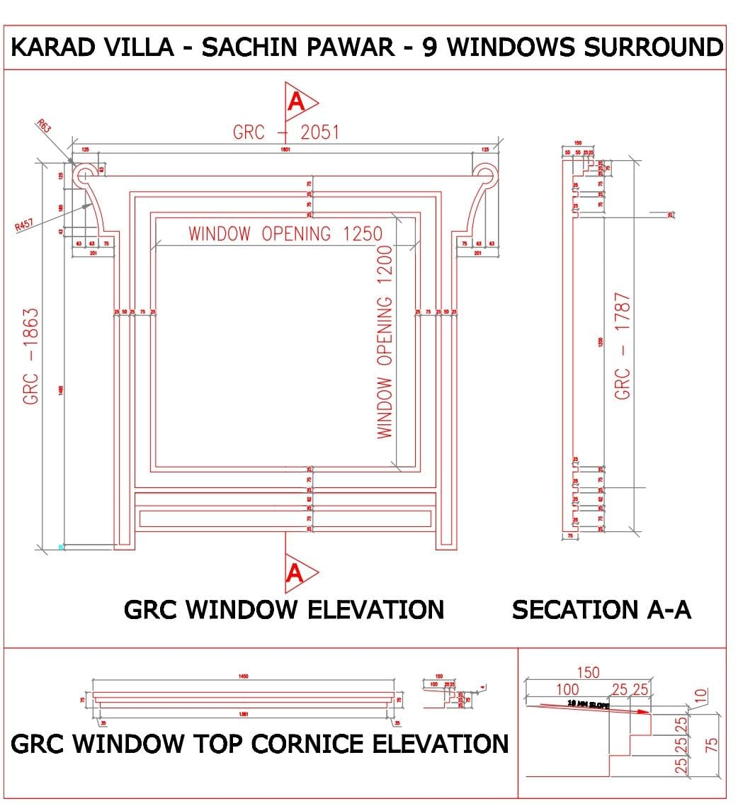
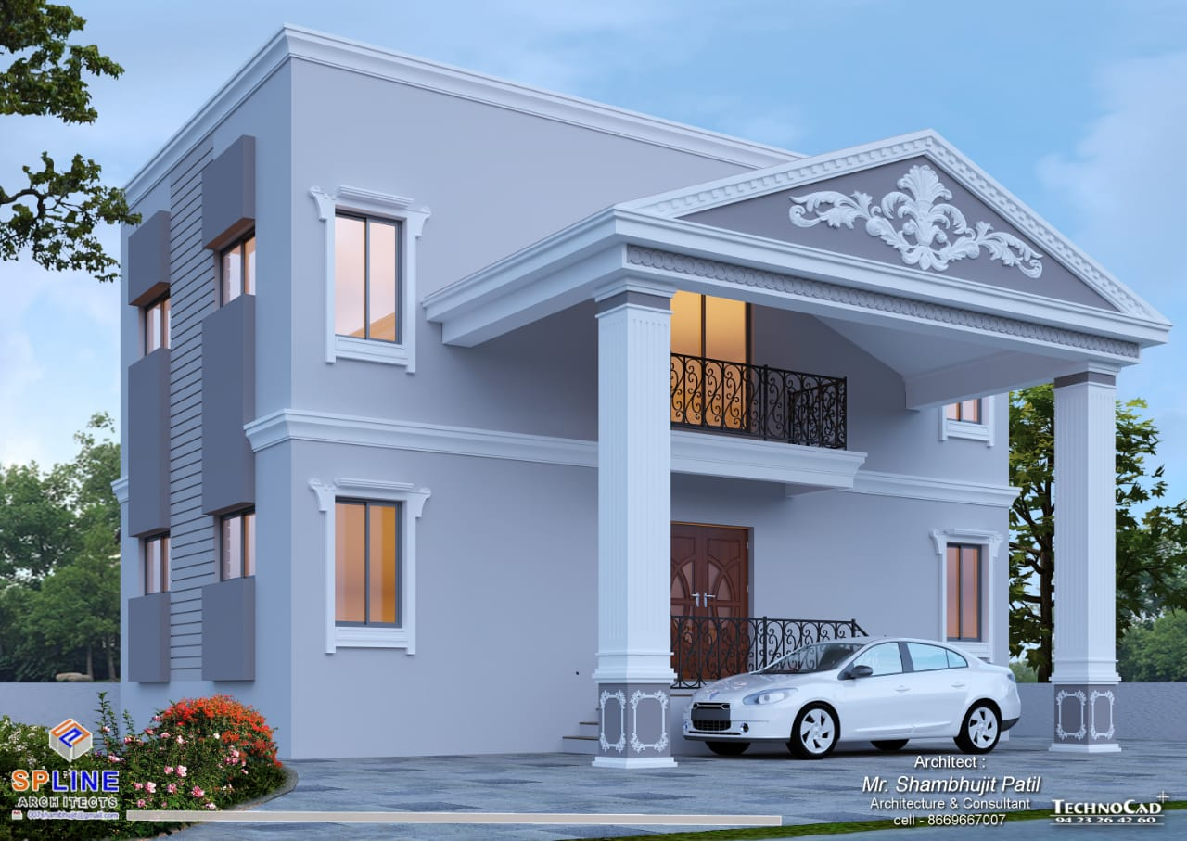
THE DESIRED
WINDOW SURROUND DETAIL

Slide 3
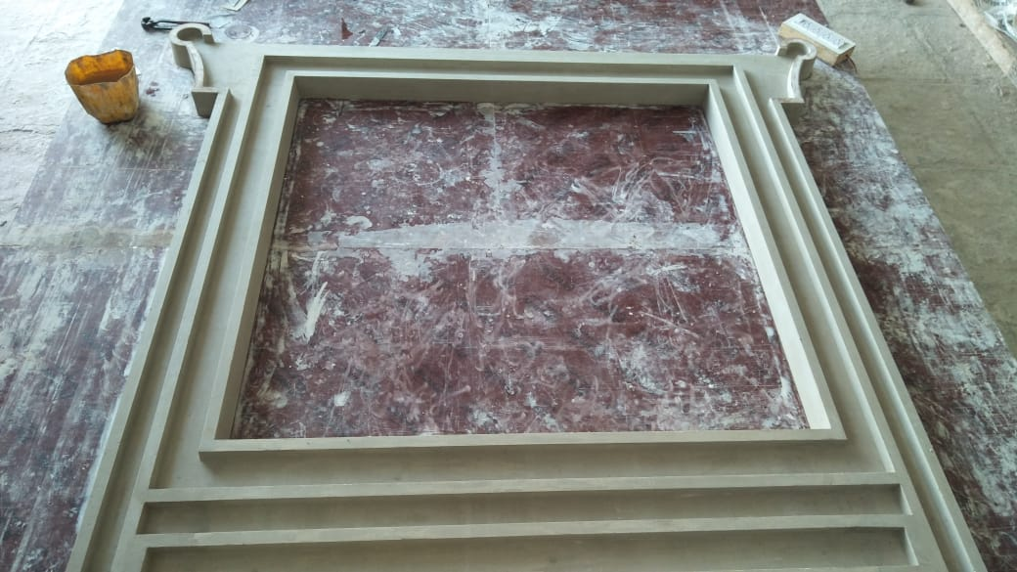
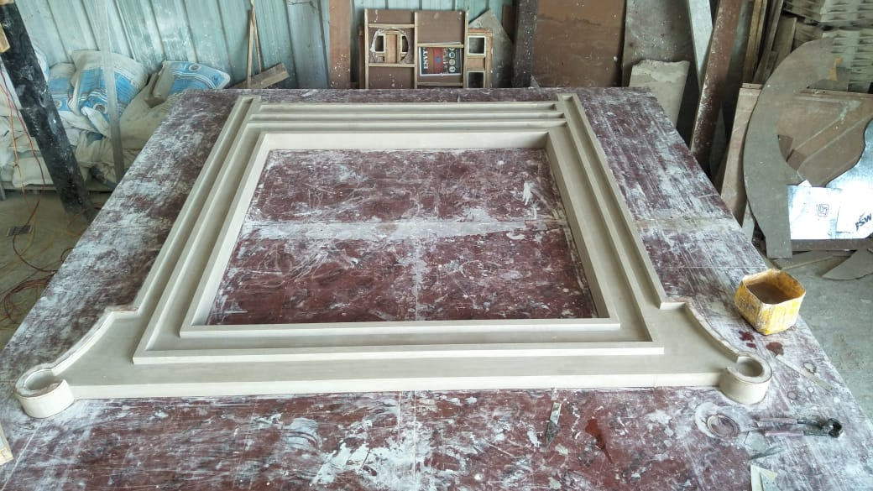
THE PATTERN CREATED IN POP

Slide 4
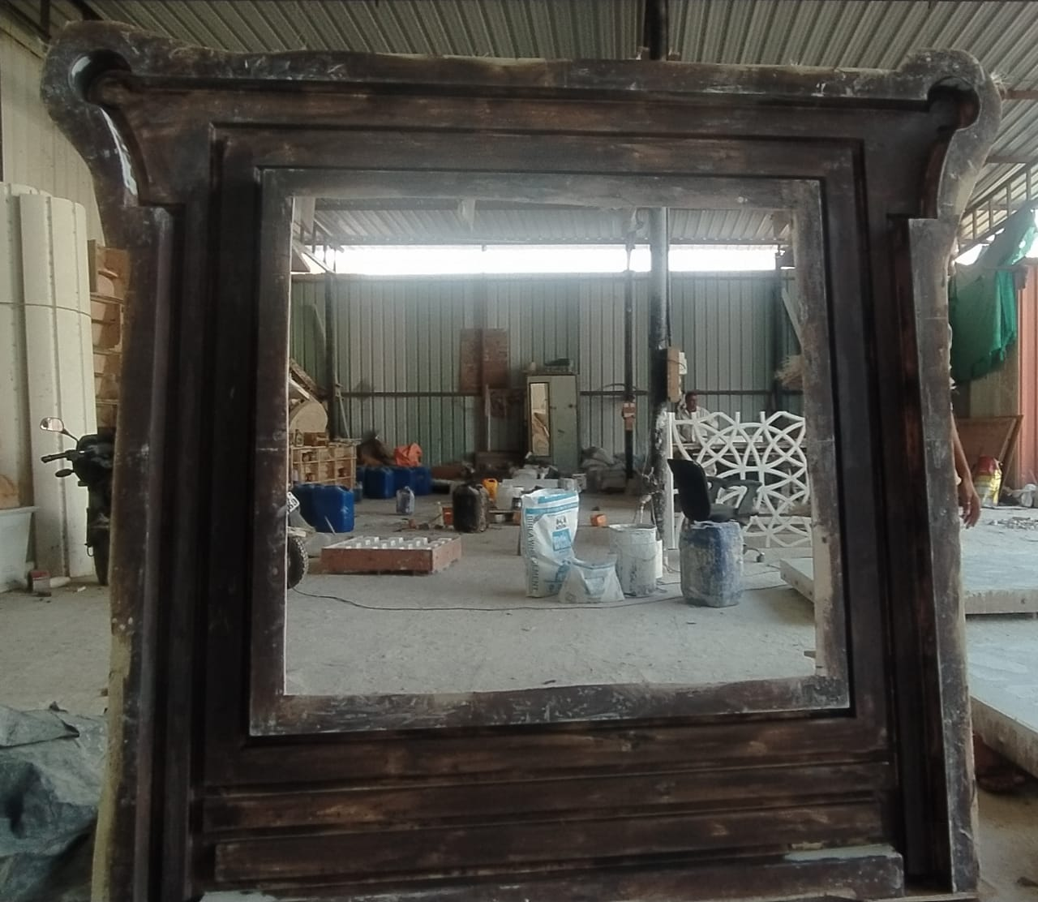
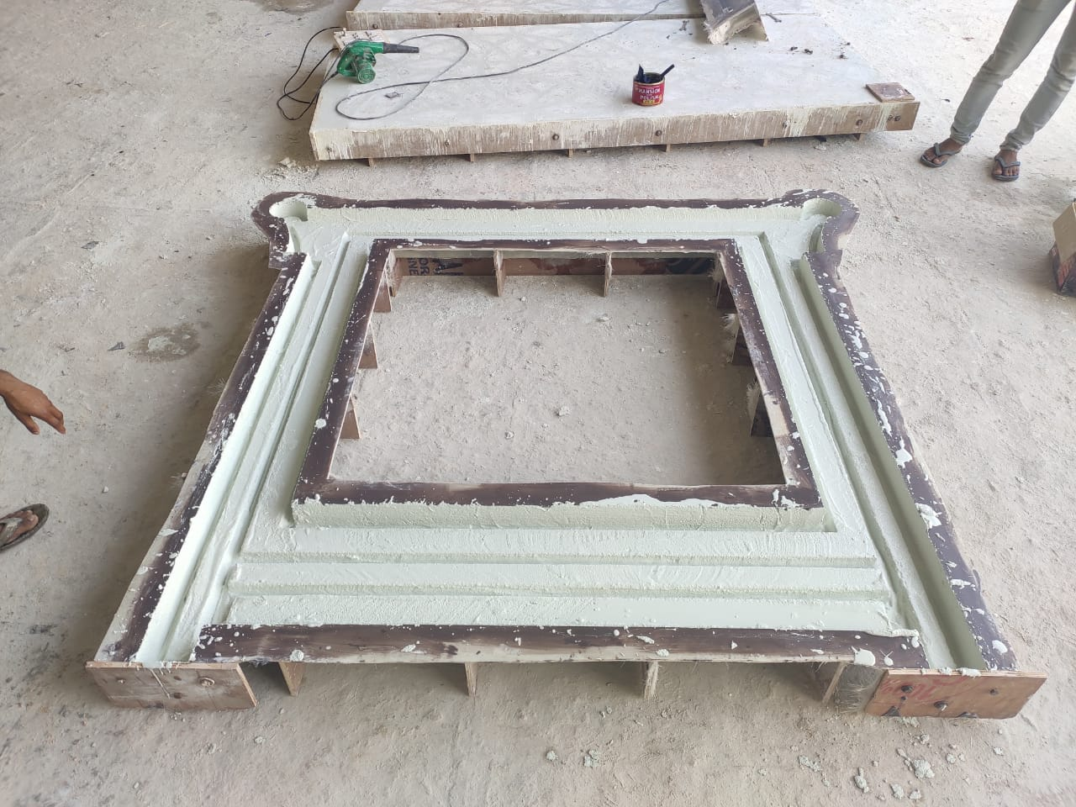
THE MOLD & ITS
CASTING IN GRC

Slide 5
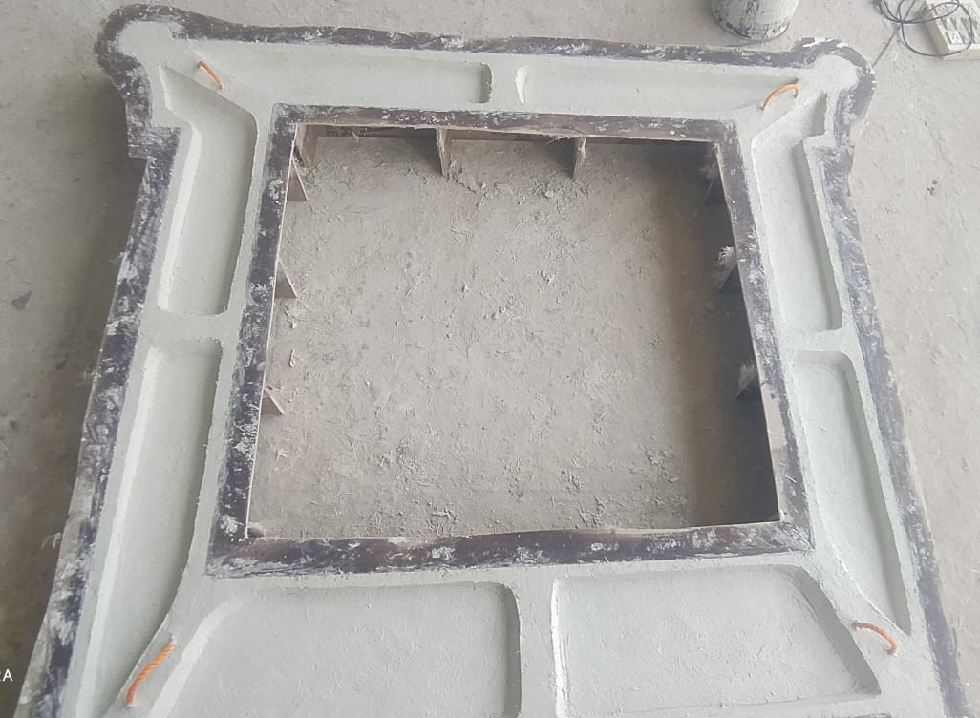
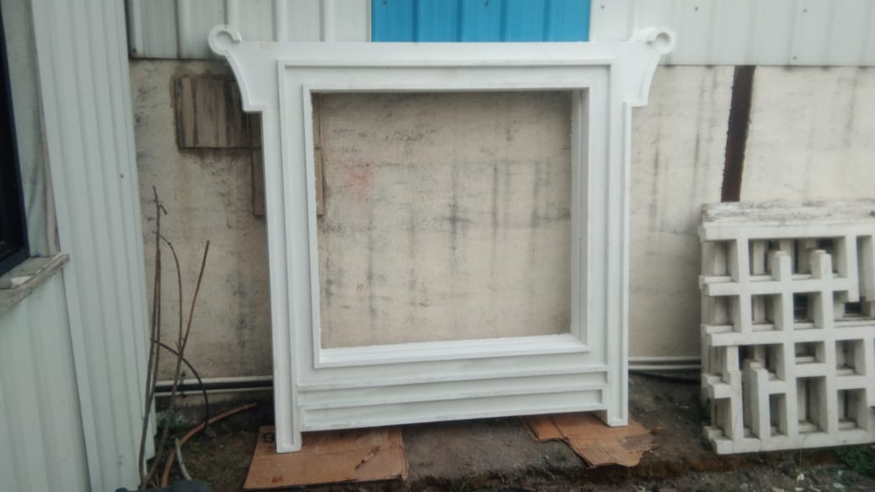
THE RIBS & BANDS ON THE BACK SIDE WITH THE FACE SIDE COMPLETED AND READY TO INSTALL

Slide 6
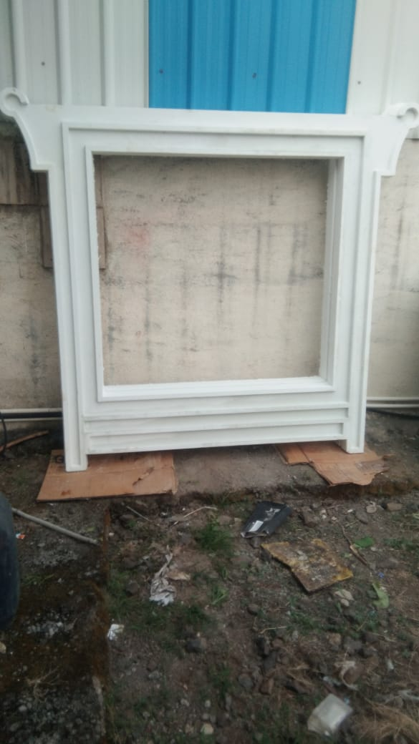
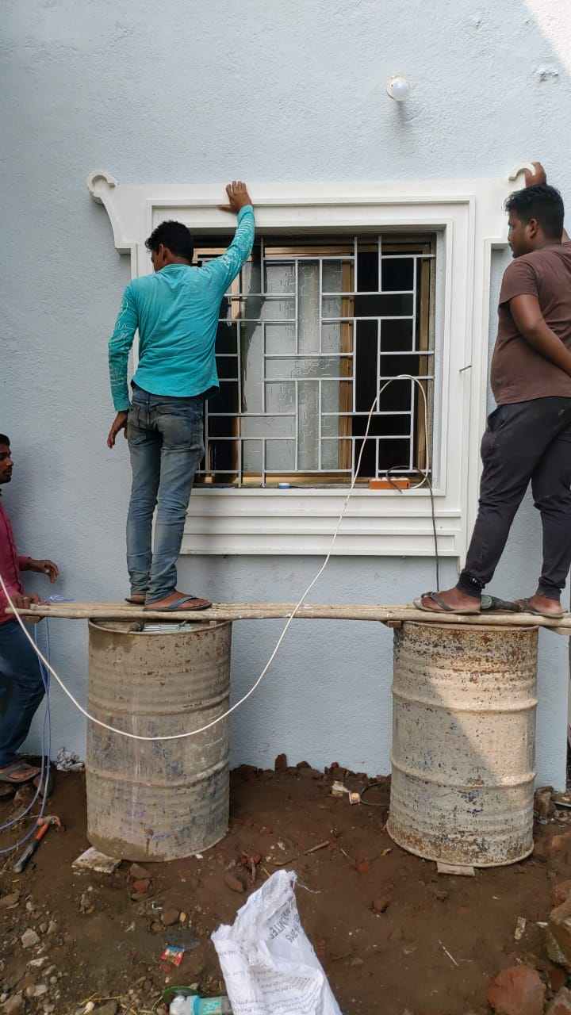
THE INSTALLATION IN PROGRESS

Slide 7
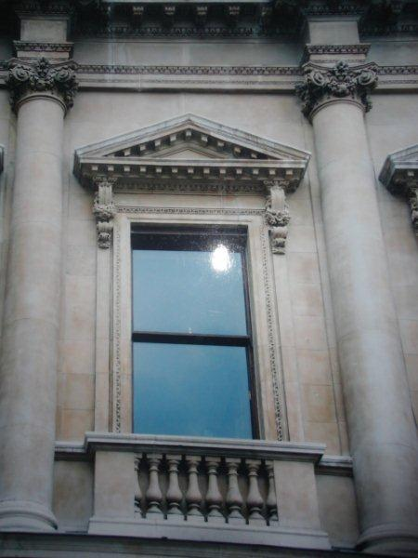
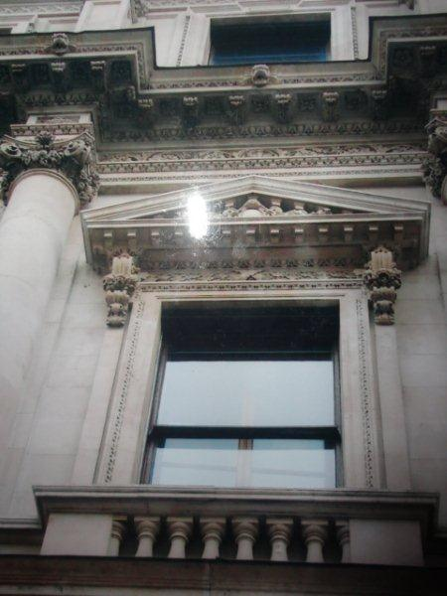
REFERENCE IMAGES
AS PROVIDED BY CUSTOMER

Slide 8
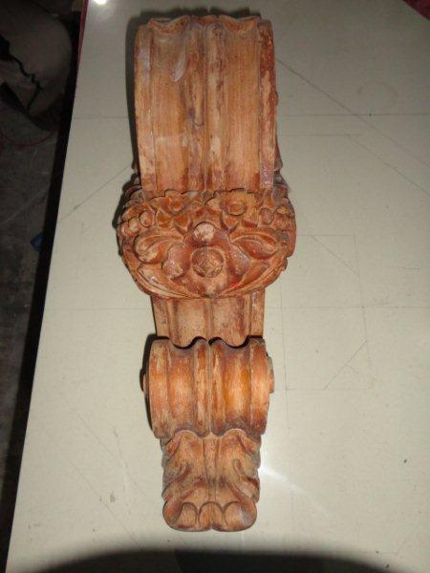
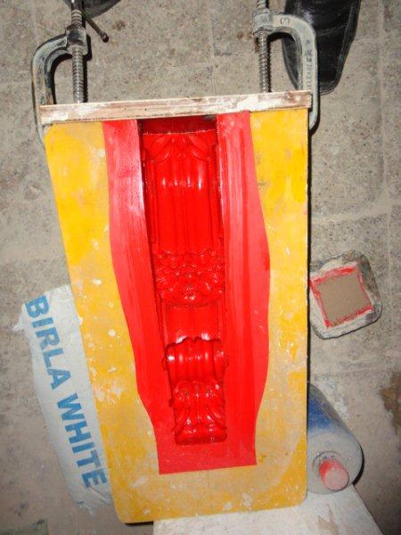
THE BRACKET
PATTERN IN WOOD & RUBBER MOULD

Slide 9
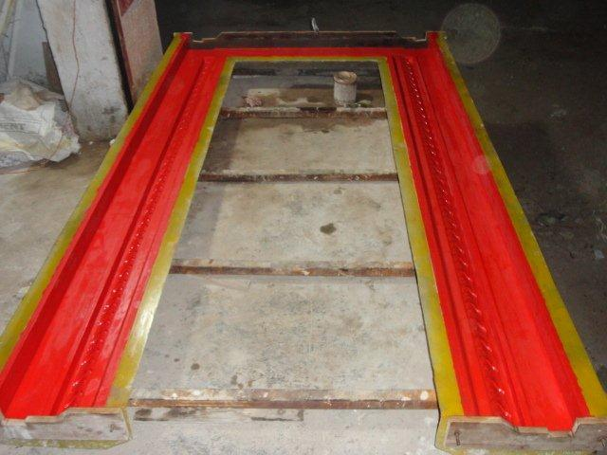
THE WINDOW FRAME
FRP BACK MOULD WITH RUBBER MASTER MOULD WITHIN

Slide 10
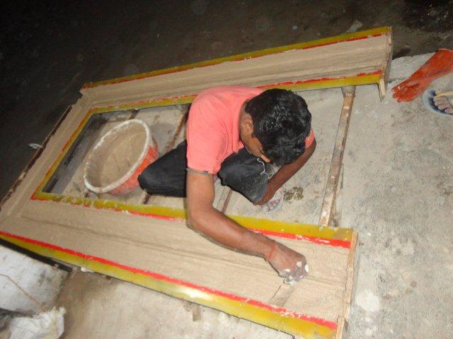
CASTING OF
THE FRAME

Slide 11
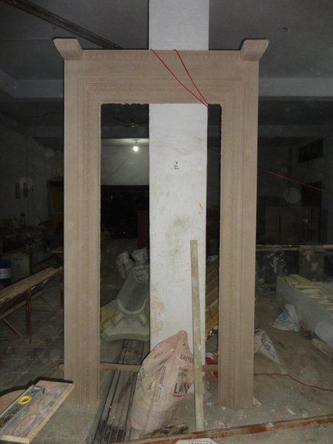
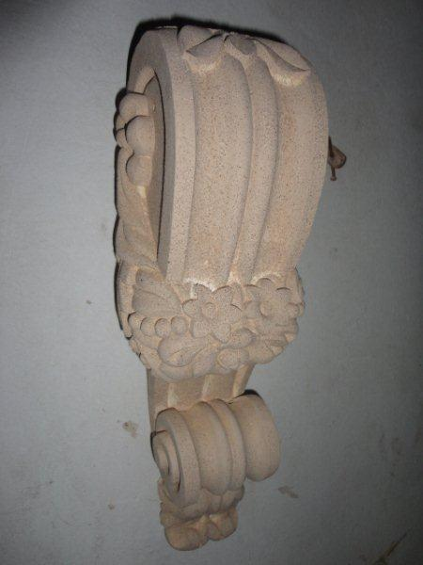
THE CASTED FRAME & BRACKET IN GRC

Slide 12
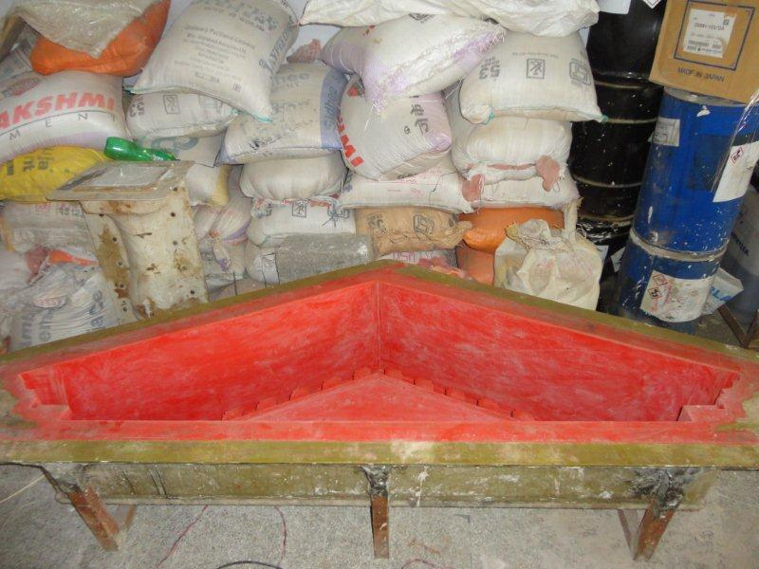
THE PEDIMENT
RUBBER MOULD

Slide 13
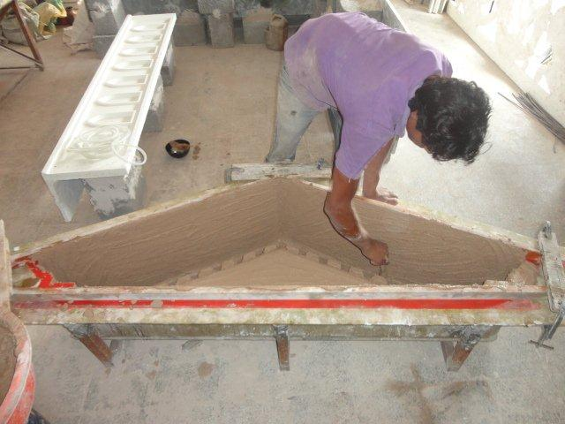
CASTING OF
THE PEDIMENT

Slide 14
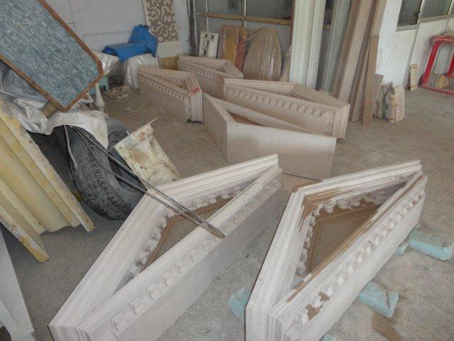
CASTED IN GRC
THE PEDIMENT

Slide 15
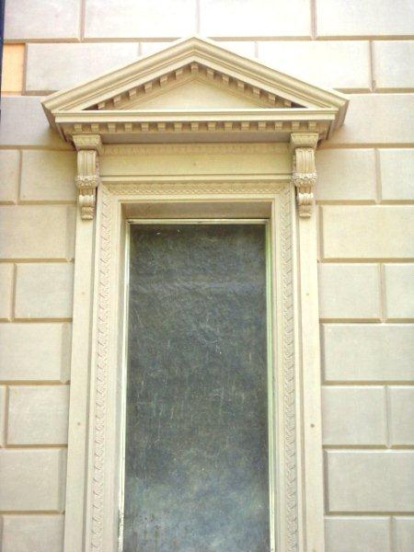
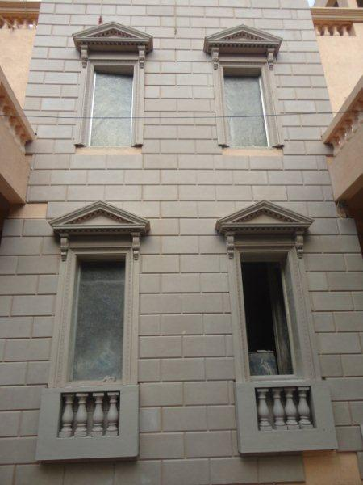
FIXING OF THE
WINDOW SURROUND

Slide 16
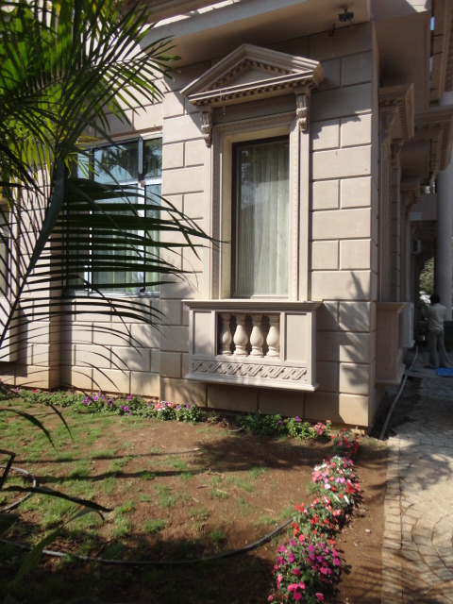
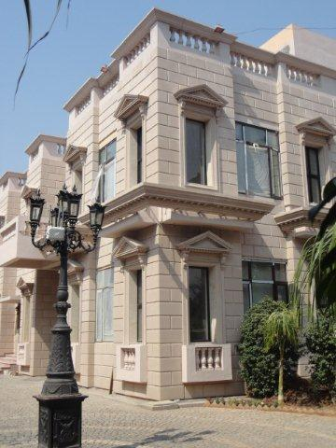
THE GRC
WINDOW SURROUND

Slide 17
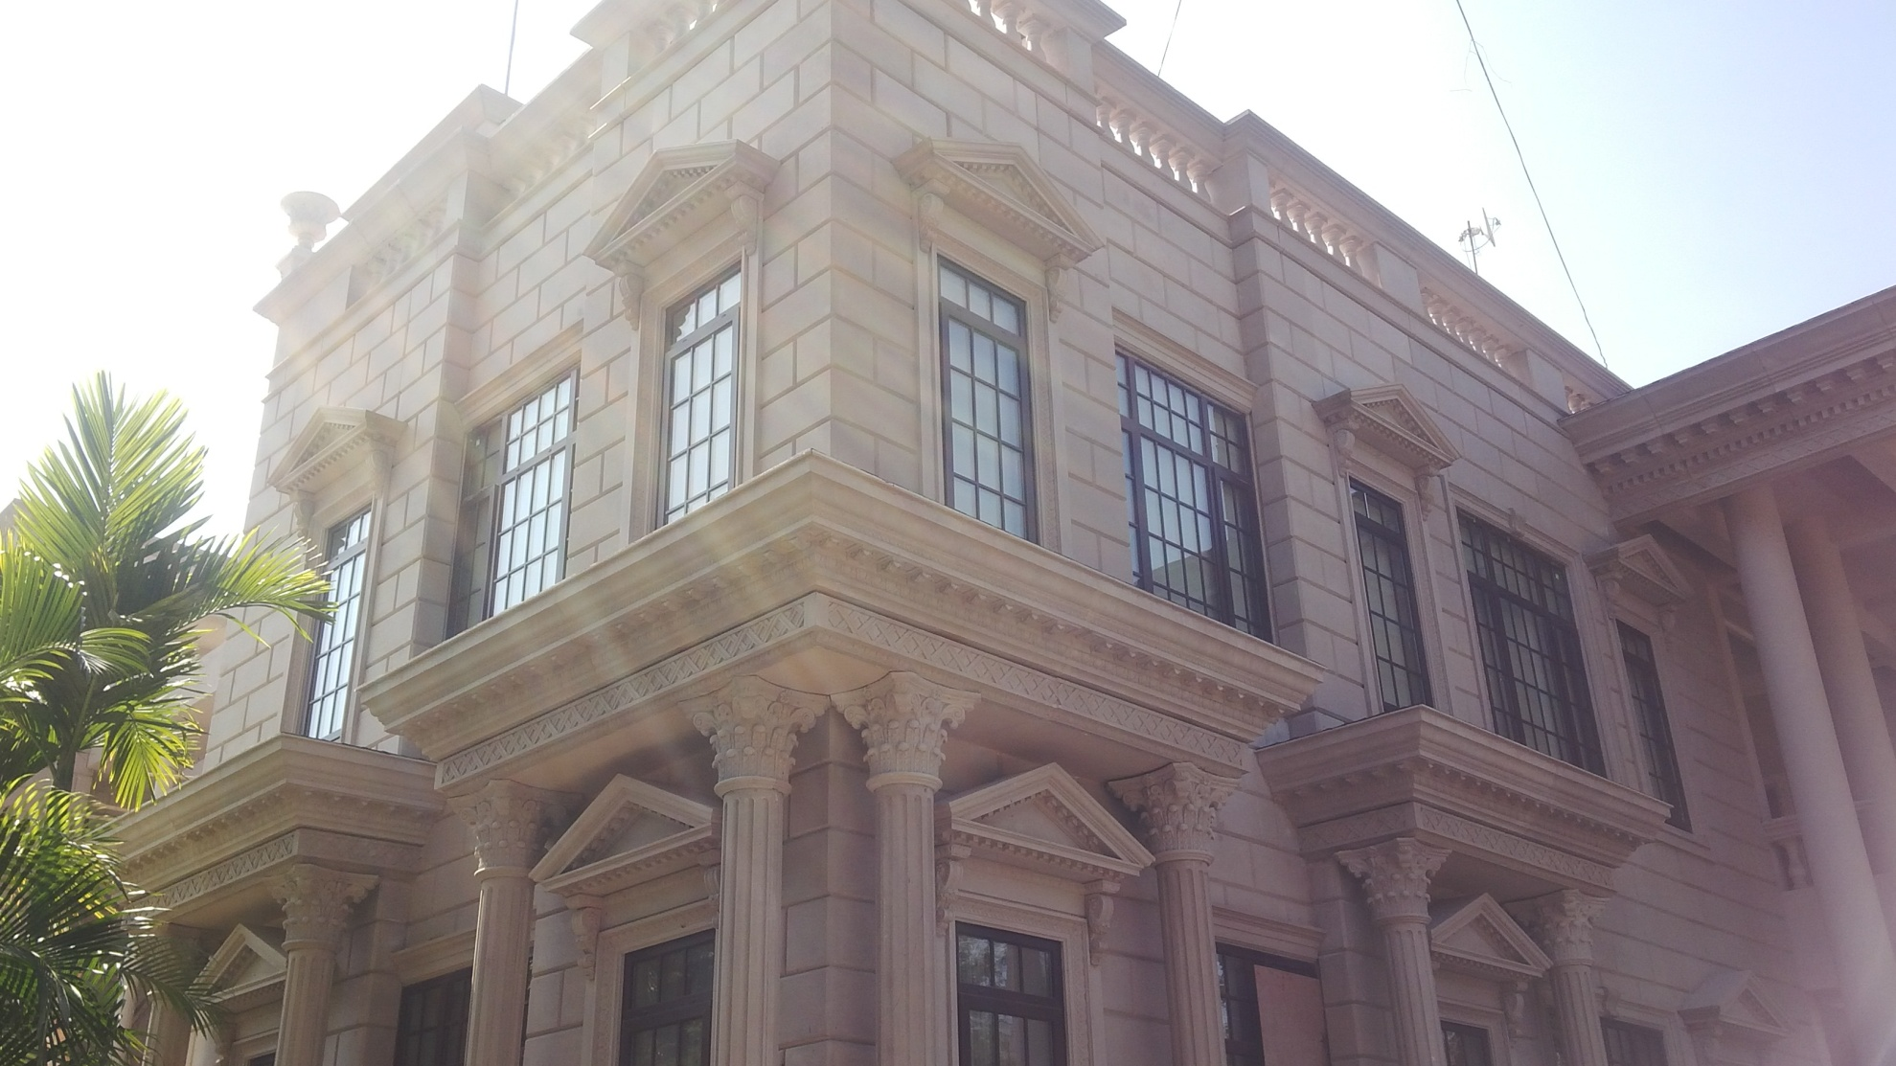
THE GRC
WINDOW SURROUND

Slide 18
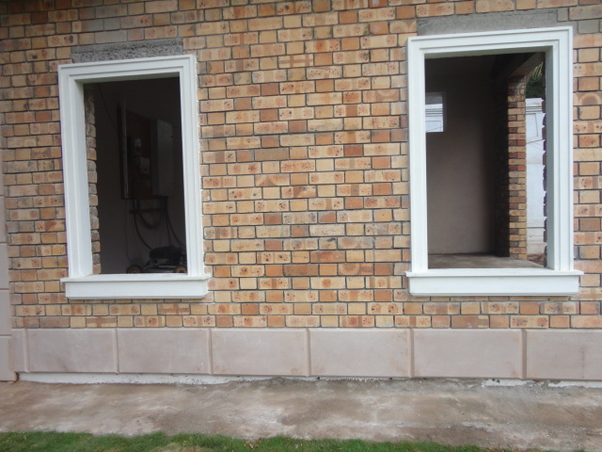
THE GRC
WINDOW FRAME

Slide 19
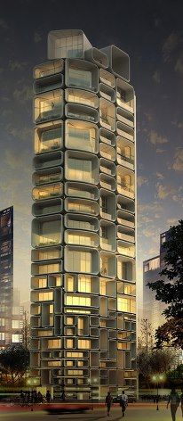
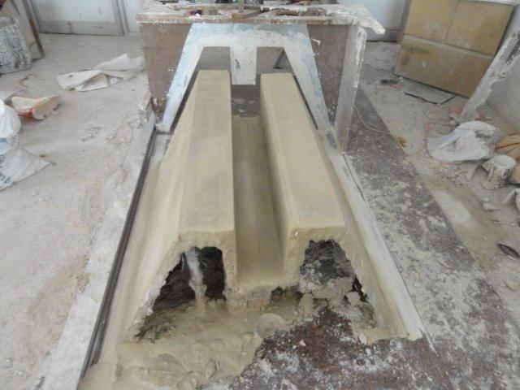
CREATING THE PERSPECTIVE

Slide 20
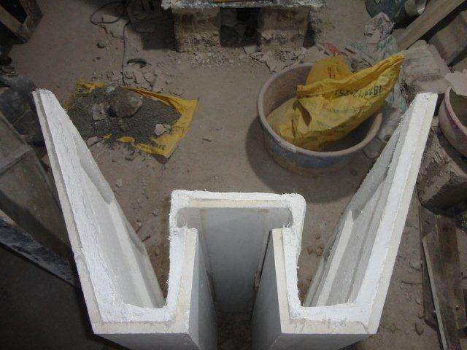
THE WINDOW SURROUND
GRC PATTERN

Slide 21
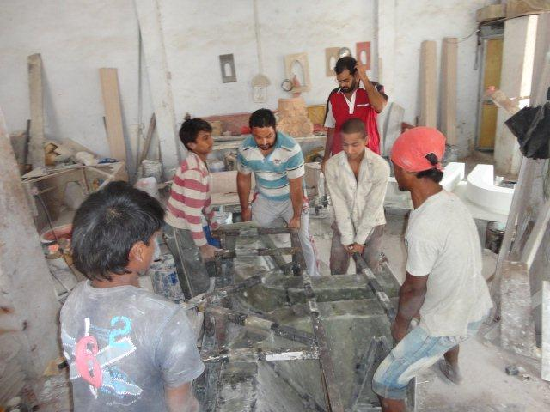
THE WINDOW SURROUND
GRC PATTERN

Slide 22
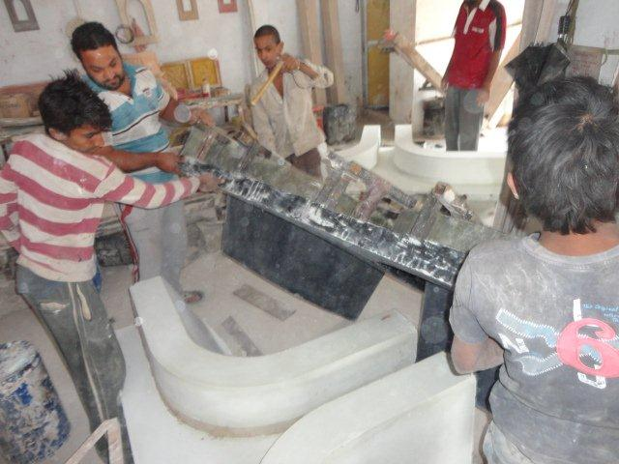
THE WINDOW SURROUND
GRC PATTERN

Slide 23
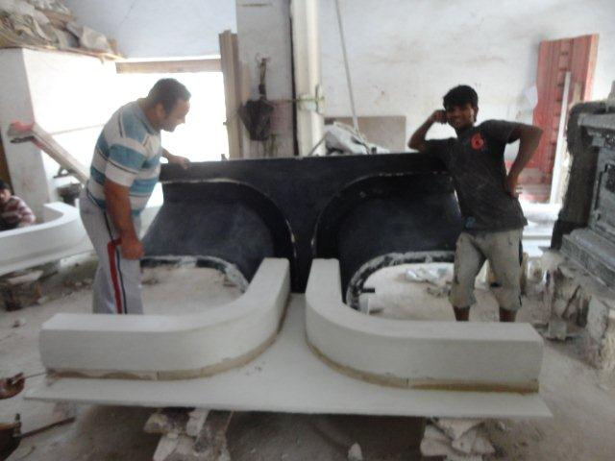
THE WINDOW SURROUND
GRC PATTERN

Slide 24
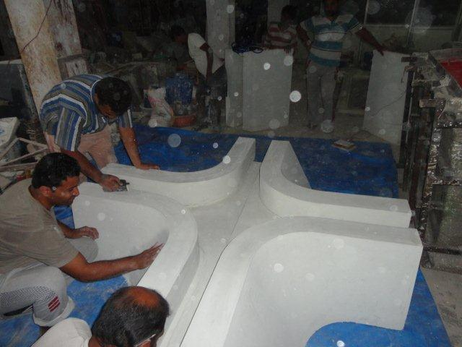
THE WINDOW SURROUND
GRC PATTERN – WINDOW JUNCTION

Slide 25
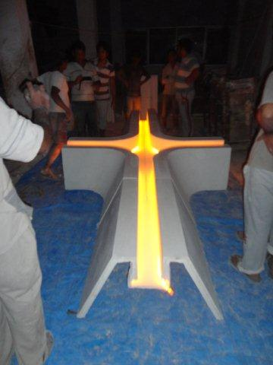
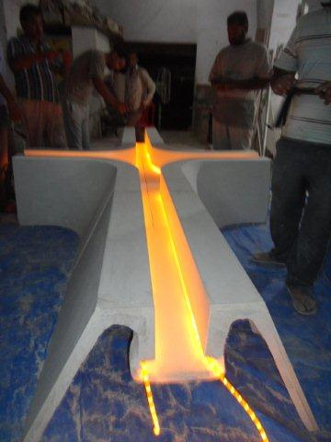
THE WINDOW SURROUND
GRC PATTERN – WINDOW JUNCTION

Slide 26
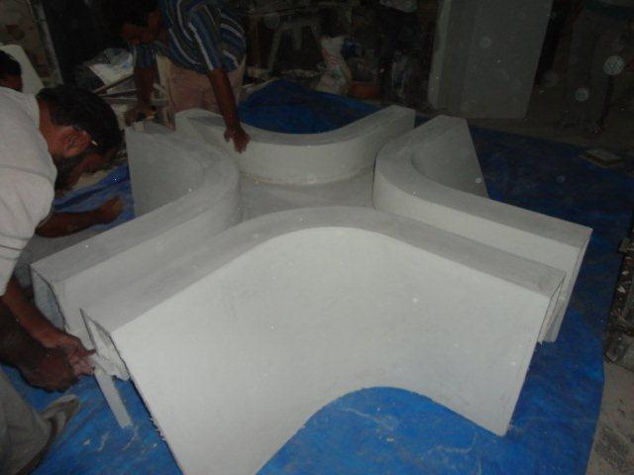
THE WINDOW SURROUND
GRC PATTERN – WINDOW JUNCTION

Slide 27
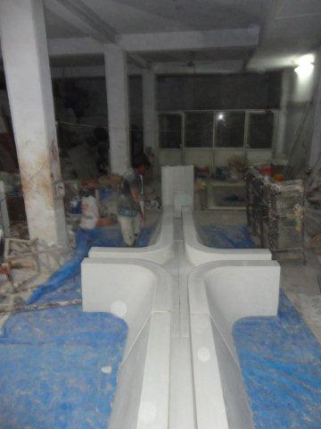
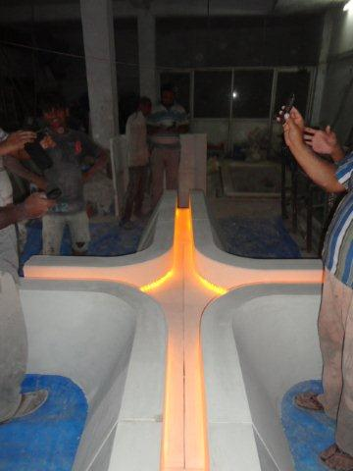
THE WINDOW SURROUND
GRC PATTERN – WINDOW JUNCTION

Slide 28
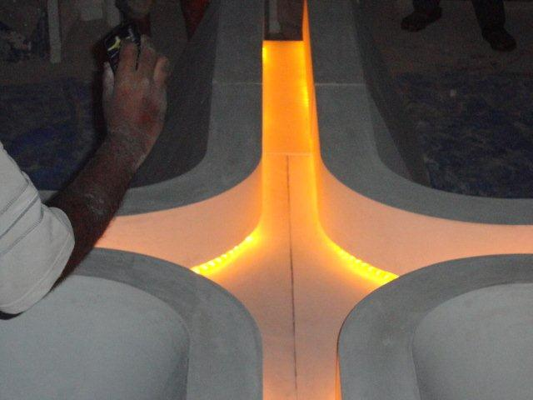
THE WINDOW SURROUND
GRC PATTERN – WINDOW JUNCTION

Slide 29
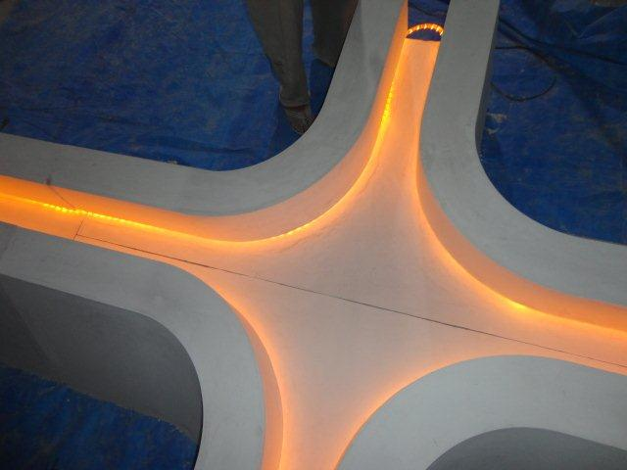
THE WINDOW SURROUND
GRC PATTERN – WINDOW JUNCTION

Slide 30
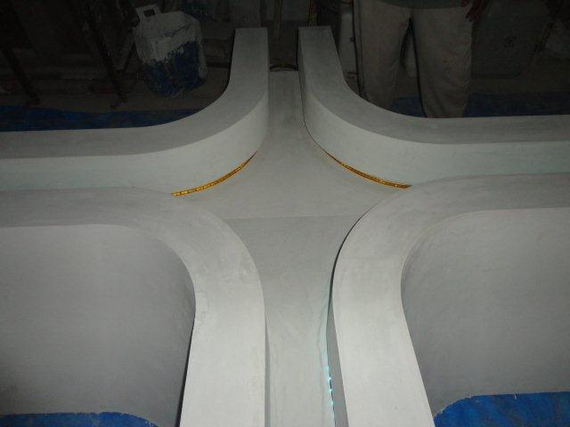
THE WINDOW SURROUND
GRC PATTERN – WINDOW JUNCTION

Slide 31
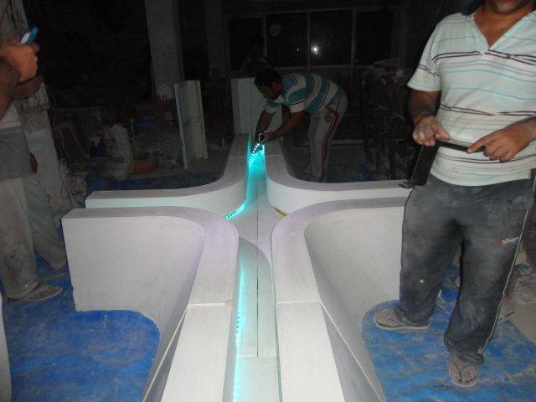
THE WINDOW SURROUND
GRC PATTERN – WINDOW JUNCTION

Slide 32
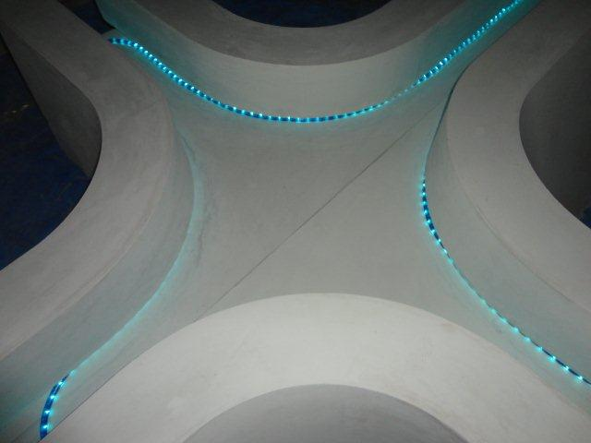
THE WINDOW SURROUND
GRC PATTERN – WINDOW JUNCTION

Slide 33
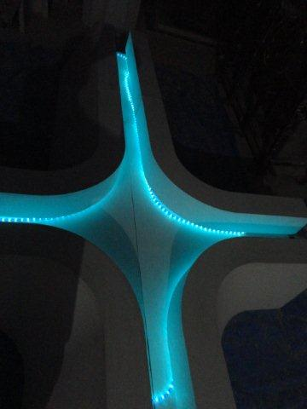
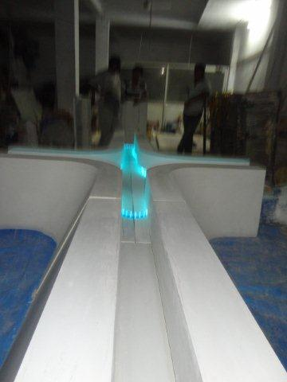
THE WINDOW SURROUND
GRC PATTERN – WINDOW JUNCTION

Slide 34
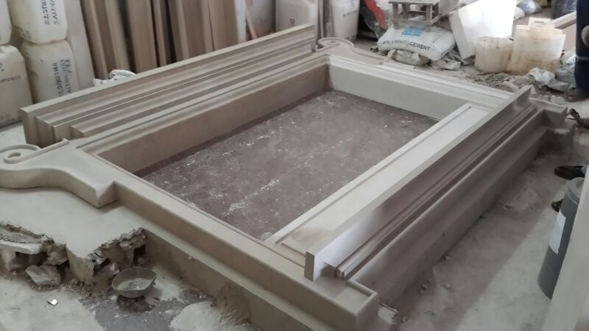
THE DECORATIVE
WINDOW SURROUND

Slide 35
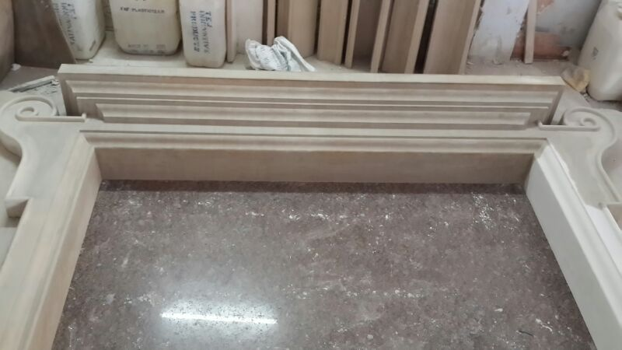
THE DECORATIVE
WINDOW SURROUND

Slide 36
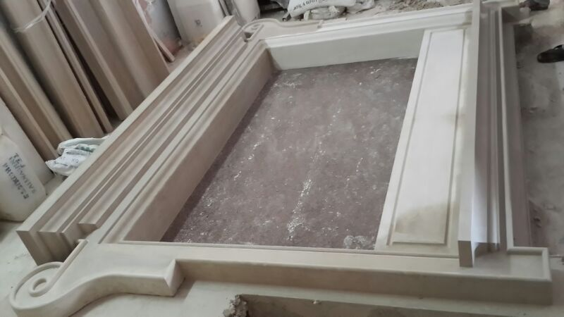
THE DECORATIVE
WINDOW SURROUND

Slide 37
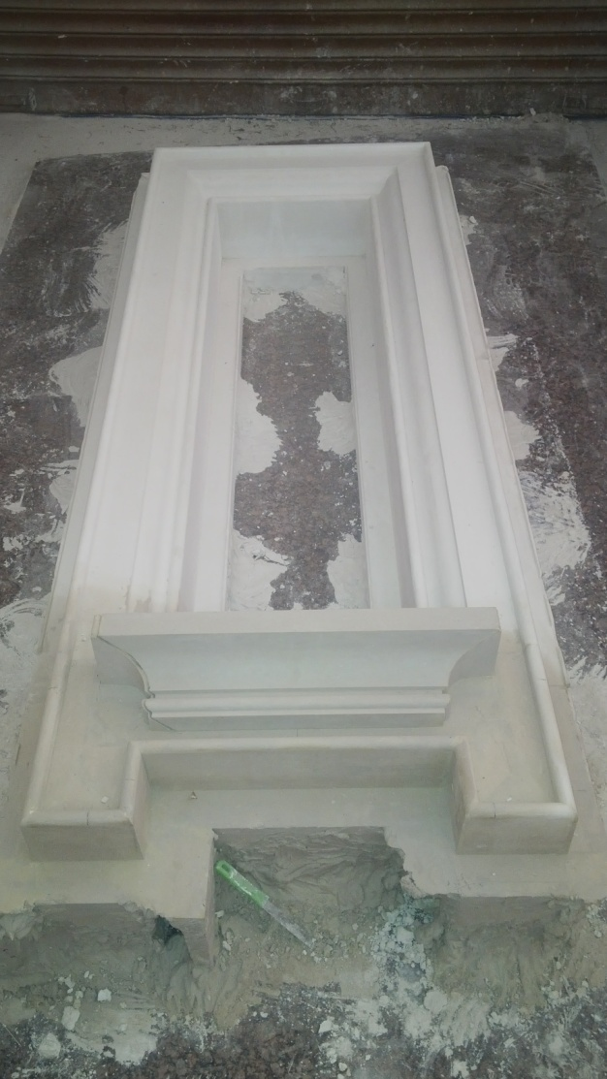

THE DECORATIVE
WINDOW SURROUND

Slide 38

THE DECORATIVE
WINDOW SURROUND

Slide 39

THE DECORATIVE
WINDOW SURROUND

Slide 40


THE DECORATIVE
WINDOW SURROUND

Slide 41

THE DECORATIVE
WINDOW SURROUND

Slide 42


DOOR & WINDOW SURROUND

Slide 43


THE DECORATIVE
WINDOW SURROUND

Slide 44

THE DECORATIVE
WINDOW SURROUND

Slide 45

THE DECORATIVE
WINDOW SURROUND

Slide 46


THE DECORATIVE
WINDOW SURROUND

Slide 47


THE DECORATIVE
WINDOW SURROUND

Slide 48

THE DECORATIVE
WINDOW SURROUND

Slide 49

THE DOOR SURROUND

Slide 50

THE DECORATIVE
WINDOW SURROUND

Slide 51

THE DECORATIVE
WINDOW SURROUND

Slide 52

THE DECORATIVE
WINDOW SURROUND

Slide 53


THE DECORATIVE
WINDOW SURROUND

Slide 54

THE DECORATIVE
WINDOW SURROUND

Slide 55

THE DECORATIVE
WINDOW SURROUND

Slide 56

THE DECORATIVE
WINDOW SURROUND

Slide 57

THE DECORATIVE
WINDOW SURROUND

Slide 58

THE DECORATIVE
WINDOW SURROUND

Slide 59

THE WINDOW SURROUND

Slide 60
CONTACT DETAILS
GFRC FACADES.
GFRC / GRC, GRG CEILINGS & PANELS, FRP WORKS, HIGH END DECORATIVE & ARCHITECTURAL WORKS & ACOUSTIC SOLUTIONS WITH EXPERTISE IN HOME THEATRES
SRIHARI NILKAR
MUMBAI
Mobile: 9867569395
nilkarsrihari@gmail.com

